Slide 1


Awais Mohammed
June 2025

Slide 2

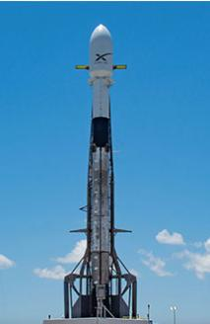
Outline
Executive Summary
Introduction
Methodology
Results
Conclusion
Appendix

Slide 3
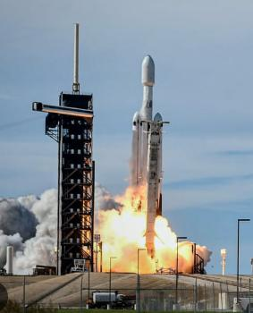
Executive Summary
In this project, a rival company to SpaceX (i.e., SpaceY) uses SpaceX Falcon 9 rocket data to determine the rocket first stage landing successes and the cost of a launch. A summary for the methodologies and results described in this report is outlined below.
Summary of methodologies
Data Collection
Data wrangling
Exploratory data analysis with data visualization and SQL
Building an interactive map with Folium
Building Dashboard with Plotly Dash
Predictive analysis (classification)
Summary of all results
Exploratory data analysis results
Interactive analytics demo in screenshots
Predictive analysis results

Slide 4
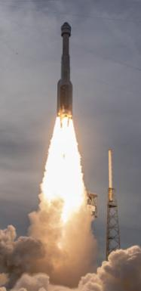
Introduction
This capstone project is part of the IBM Data Science Professional Certificate. The goal of the project is to demonstrate proficiency in data science and machine learning techniques using a real-world data and to summarize the results in a report.
In this project, a rival company to SpaceX (i.e., SpaceY) uses SpaceX Falcon 9 rocket data to determine the rocket first stage landing successes and uses the rocket data to determine the cost of a launch. Space Y uses the data to bid against SpaceX for a rocket launch. SpaceX advertises Falcon 9 rocket launch cost to be 62 million dollars. Whereas for other companies the cost of a rocket launch is more than 165 million dollars.
Throughout the project Python Jupyter notebooks are used to perform the data collection and analysis. These Jupyter notebooks and the final *.pdf report are saved in my GitHub repository webpage.
The major parts of this report include data collection methodology, data wrangling, exploratory data analysis (EDA), interactive data visualization, machine learning (ML) classification model development, and model evaluation. Finally, the accuracy of different ML algorithms are compared in predicting the future landing of the Falcon 9 first stage rocket.

Slide 5

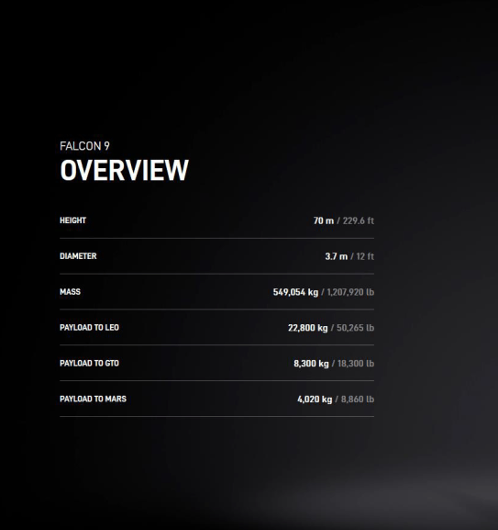
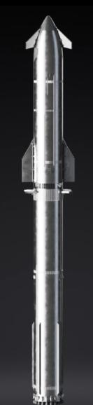
Section 1

Slide 6
Methodology
Data used in this project were collected from SpaceX Rest API and from Wikipedia launch table. The wrangling of the collected data included cleaning, preparation for visualization and information extraction for usage in ML predictive models such as logistic regression, support vector machine (SVM), decision tree, and K-nearest neighbours (KNN).
In addition, exploratory data analysis (EDA) was performed using visualization and SQL. Lastly, Folium and Plotly Dash Python libraries were use in data representation and in the interactive visual analytics of the data.
Finally, predictive analysis was performed using classification models for predicting if the first stage of Falcon 9 rocket will land successfully using Skikit-learn and the accuracy of the model was determined.

Slide 7
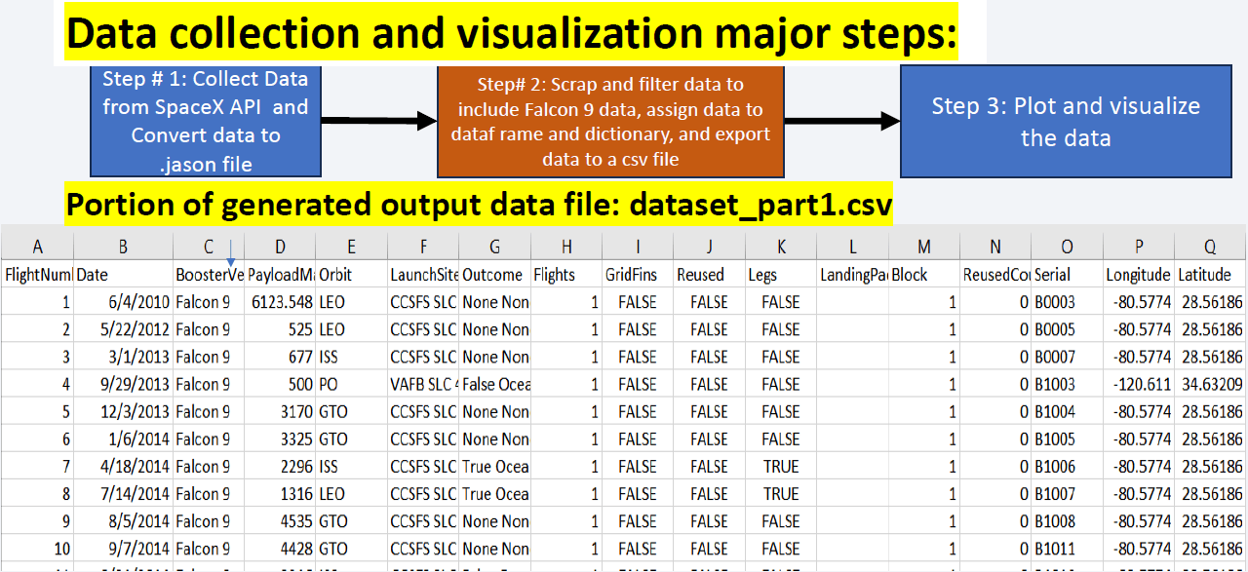
Data Collection: Overview

Slide 8
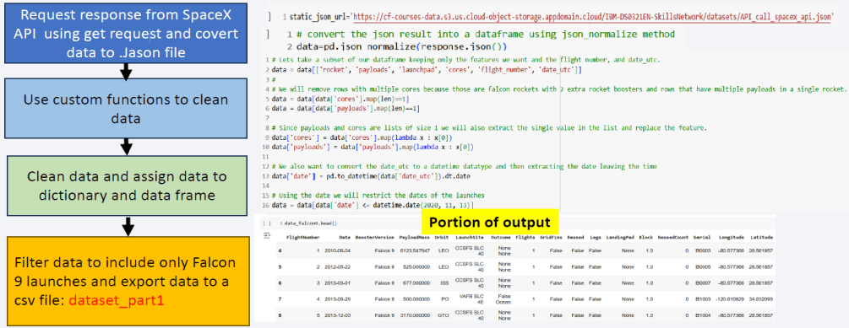
Data Collection – SpaceX API

Slide 9
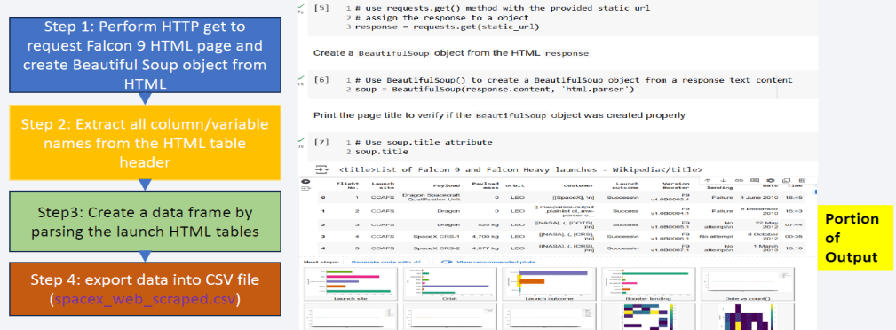
Data Collection - Scraping

Slide 10
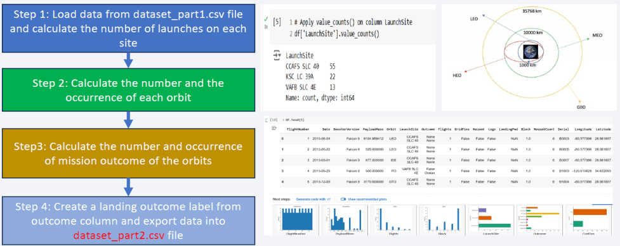
Data Wrangling

Slide 11
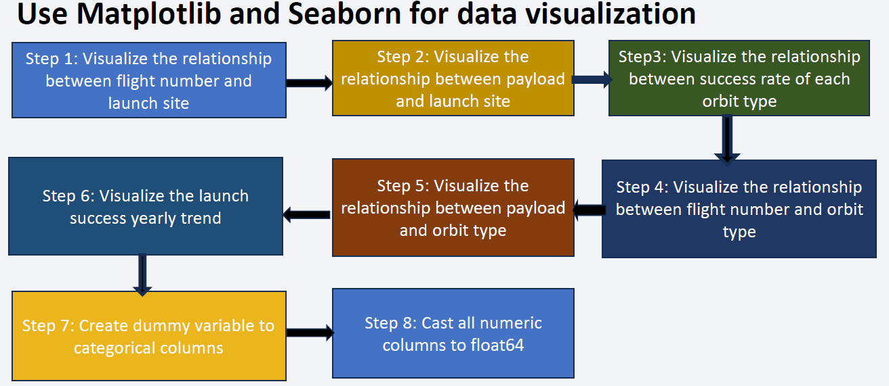
EDA with Data Visualization

Slide 12
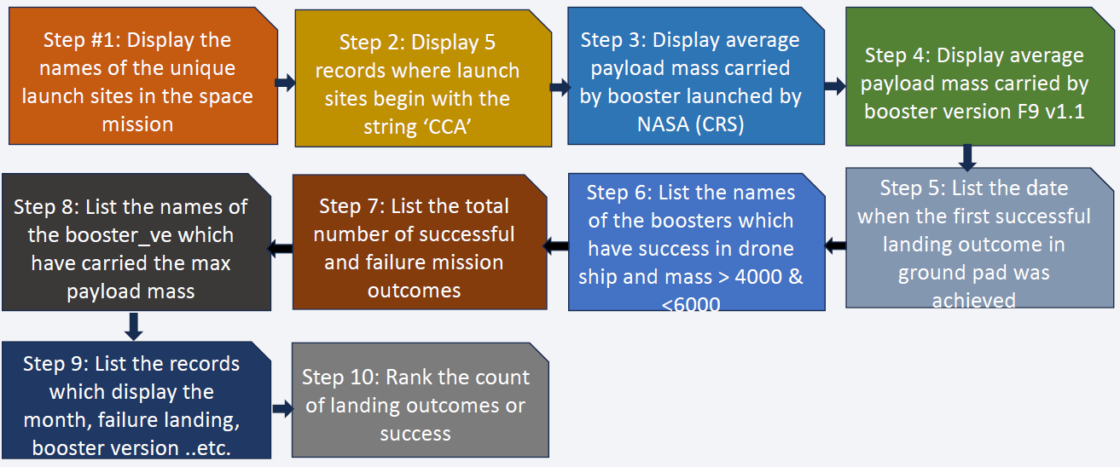
EDA with SQL

Slide 13
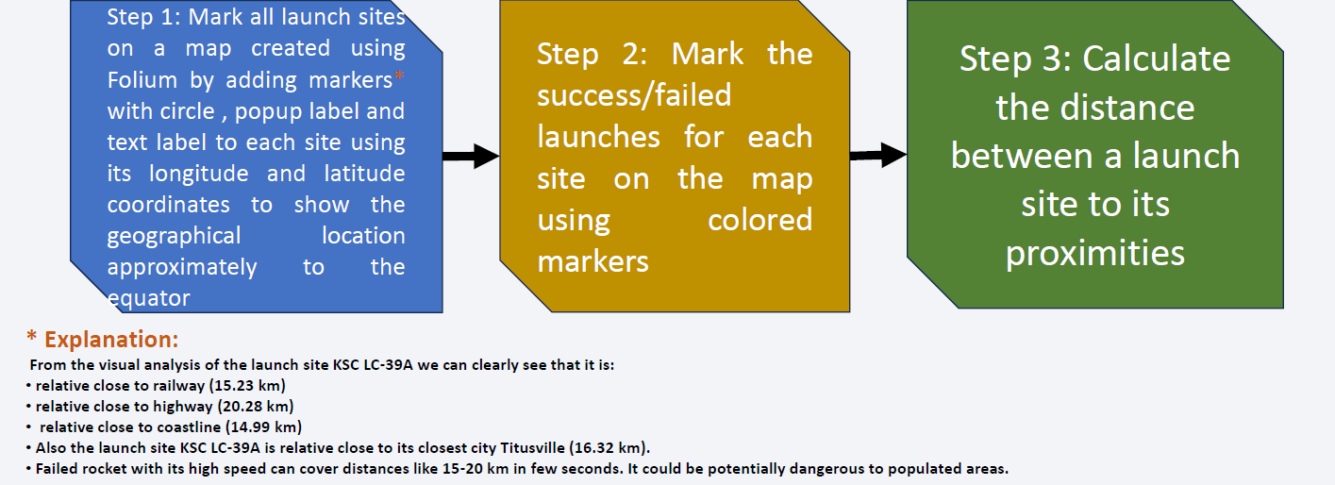
Build an Interactive Map with Folium

Slide 14
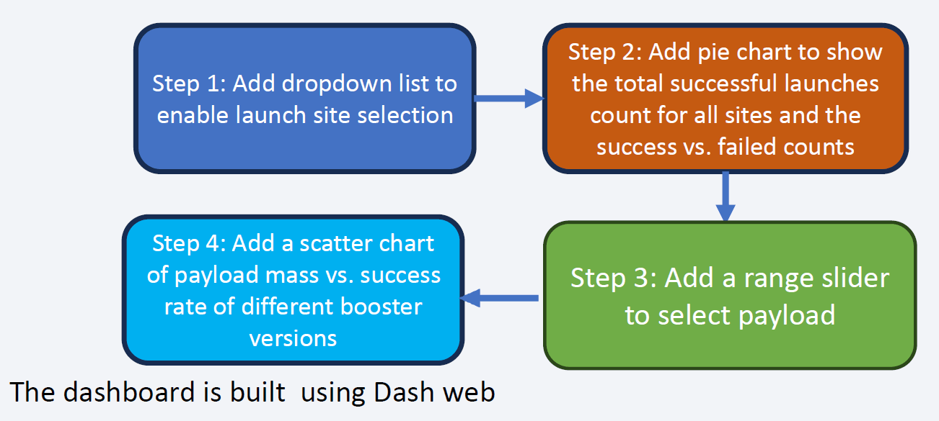
Build a Dashboard with Plotly Dash

Slide 15
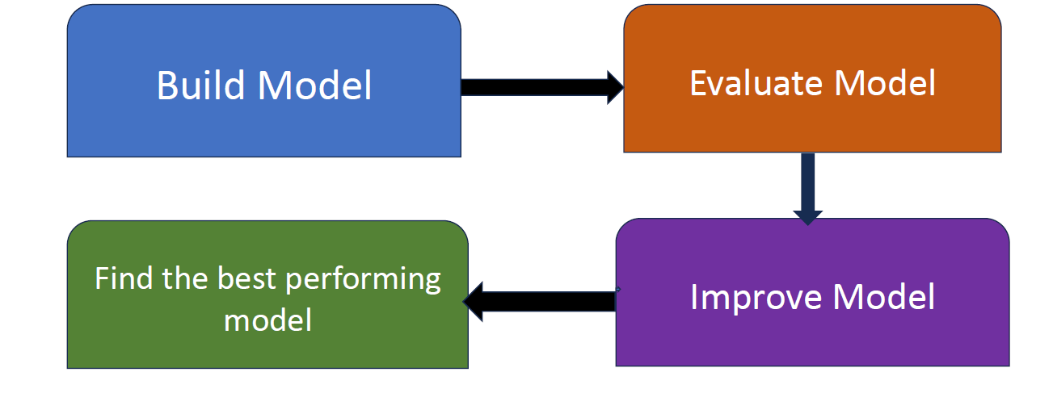
Predictive Analysis (Classification): Overview
Summarize how you built, evaluated, improved, and found the best performing classification model
You need present your model development process using key phrases and flowchart
Add the GitHub URL of your completed predictive analysis lab, as an external reference and peer-review purpose

Slide 16
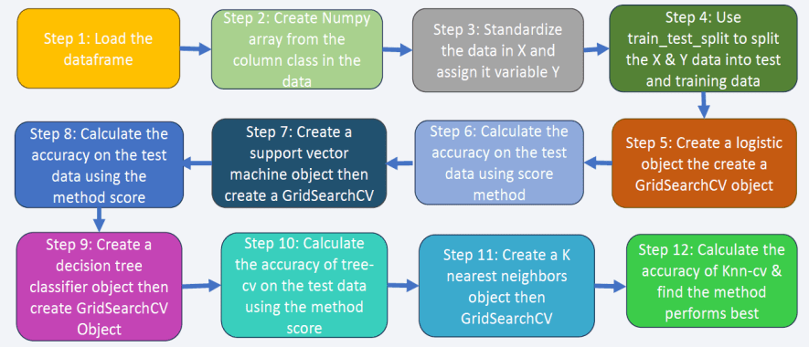
Predictive Analysis (Classification): Steps

Slide 17
Results
Exploratory data analysis results
Interactive analytics demo in screenshots
Predictive analysis results

Slide 18

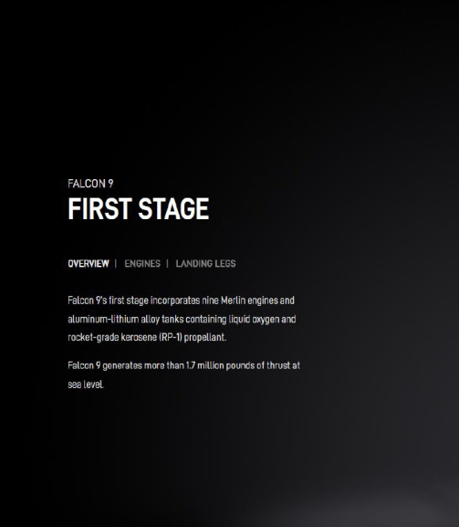
Section 2

Slide 19
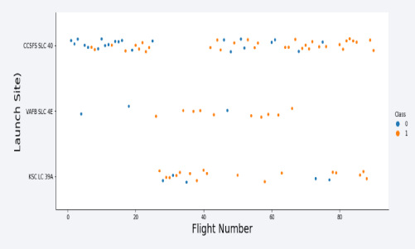
Flight Number vs. Launch Site
The majority of the flights were launched from the CCAFS SLC 40 sites.
The VAFB SLC 4E and KSC LC 39A sites have higher success rates than other sites.
Newer flights have higher success rates than older flights.

Slide 20
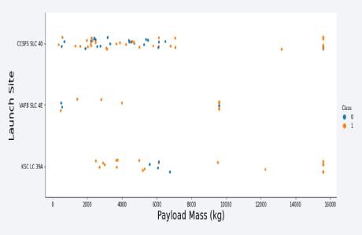
Payload vs. Launch Site
The majority of the flights with payload mass above 7000 Kg were successful.
KSC LC 39A success rate for payload mass under 5500 kg is 100%.
For all launch sites the success rate is proportional to the payload mass.

Slide 21
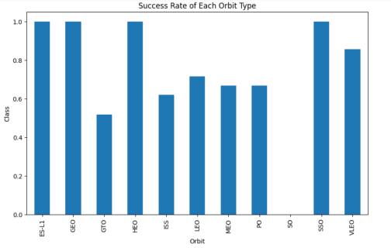
Success Rate vs. Orbit Type
The OS orbit has 0% success rate.
The ELS-1, GEO, HEO and SSO orbits have 100% success rate.
Orbits GTO, ISS, LEO, MEO and PO success rate is higher than 50% and less than 75%.

Slide 22
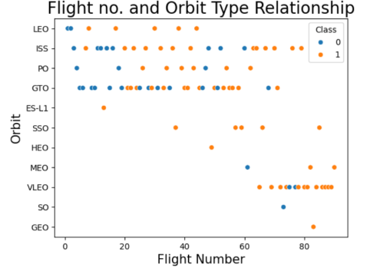
Flight Number vs. Orbit Type
The majority of the flights were launches to the ISS and GTO orbits.
The data suggests that there is no relationship between the flight number and the orbit type.

Slide 23
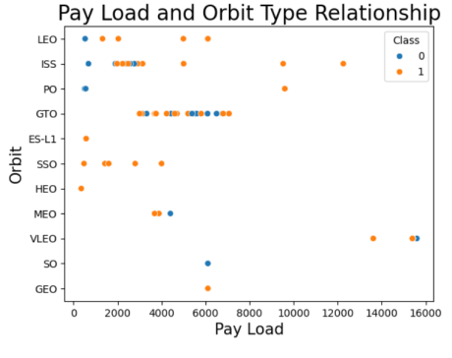
Payload vs. Orbit Type
Payload masses above 10000 Kg were placed in PO, ISS and LEO orbits.
Payload masses above 4000 and less than 8000 Kg were placed in the GTO orbit.

Slide 24
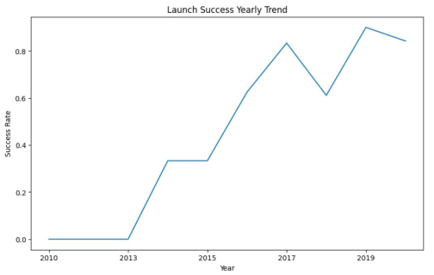
Launch Success Yearly Trend
The launches success rate increased steadily since 2013.
The increase in the success rate between 2013 and 2017 was linear.
During 2018 there was a drop in the launches success rate.

Slide 25
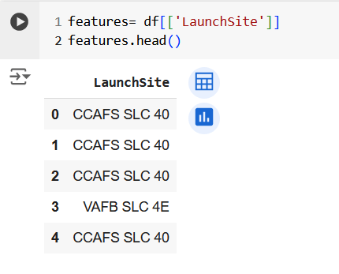
All Launch Site Names
The names of the unique launch sites and the query structure for obtaining these sites is shown below.

Slide 26
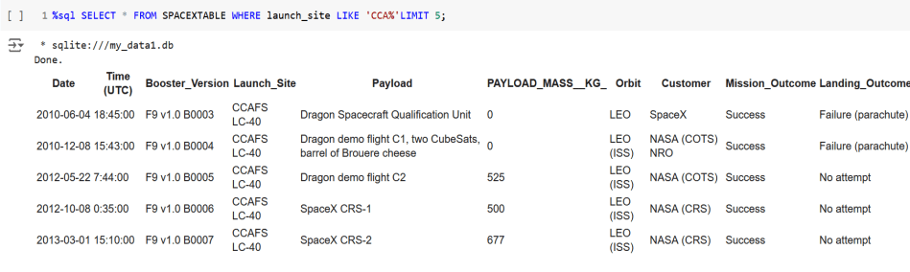
Launch Site Names Begin with 'CCA'
5 records for launch sites begin with the string 'CCA’ and the query used for obtaining the information is shown below.

Slide 27
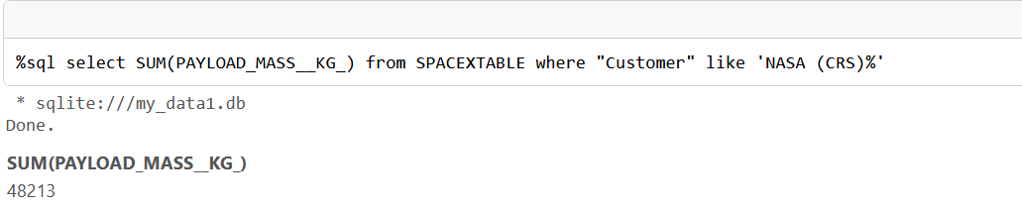
Total Payload Mass
The calculated total payload mass carried by boosters from NASA site =45596 Kg.
The query for obtaining the total payload mass is shown below.

Slide 28
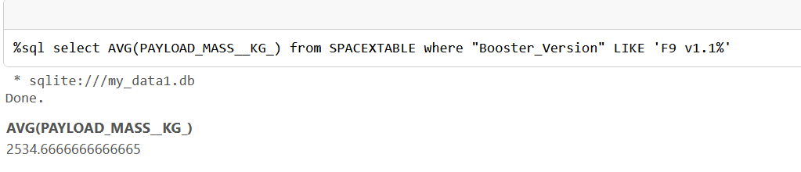
Average Payload Mass by F9 v1.1
The average payload mass carried by booster version F9 v1.1=2534.7 Kg.
Furthermore, the query used to calculate the average payload mass carried by booster F9 v1.1 is shown below.

Slide 29
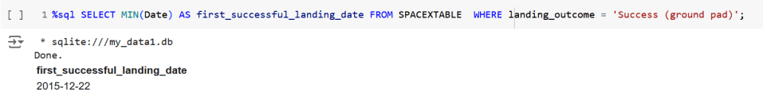
First Successful Ground Landing Date
The first successful landing outcome on a ground pad was in 2015-12-22.
The query for obtaining this result is shown below.

Slide 30
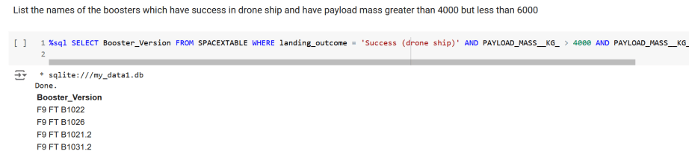
Successful Drone Ship Landing with Payload between 4000 and 6000
List of boosters which have successfully landed on drone ship and had payload mass greater than 4000 but less than 6000 is shown below.
The query used in obtaining this information is shown below.

Slide 31
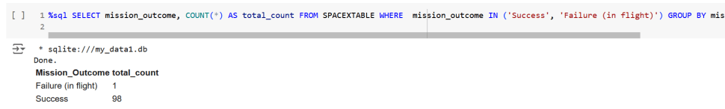
Total Number of Successful and Failure Mission Outcomes
The total number of successful and failed missions is as follows:
Failure (in flight)= 1
Successful number of flights= 98
The query result is shown below.

Slide 32
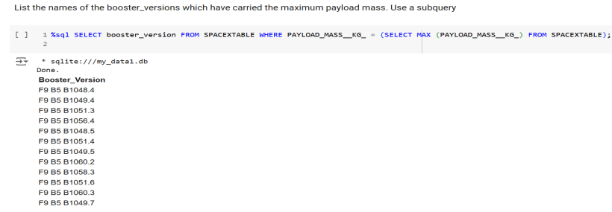
Boosters Carried Maximum Payload
List of the boosters which have carried the maximum payload mass are shown below.
The query used in obtaining the booster names is shown below.

Slide 33
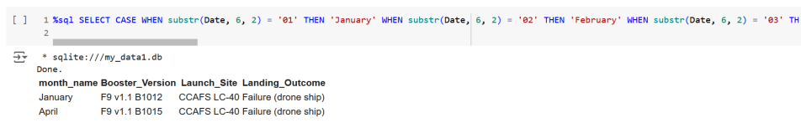
2015 Launch Records
List of the failed”landing_outcomes” in drone ship, their booster version, andthe launch site name during year 2015 is shown below.
The query used in obtaining the information is shown below.

Slide 34
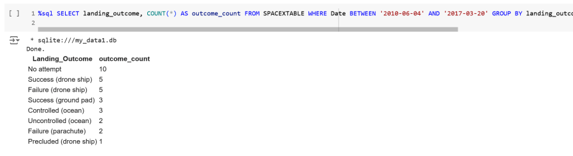
Rank Landing Outcomes Between 2010-06-04 and 2017-03-20
A rank of the count of landing outcomes (such as Failure (drone ship) or success (ground pad)) between the dates 2010-06-04 and 2017-03-20, in descending order is shown below.
The query used to obtain the results is shown below.

Slide 35

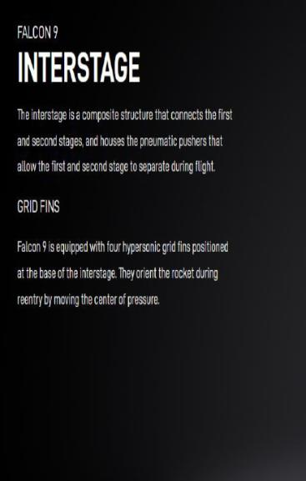
Section 3

Slide 36
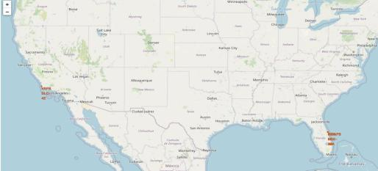
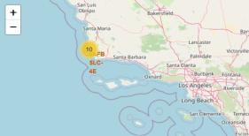
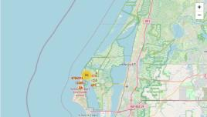
USA Launch Sites in California and Florida
Most of Launch sites considered in this project are in proximity to the Equator line. Launch sites are made at the closest point possible to Equator line, because anything on the surface of the Earth at the equator is already moving at the maximum speed (1670 kilometers per hour). For example, launching from the equator makes the spacecraft move almost 500 km/hour faster once it is launched compared halfway to north pole.
All launch sites considered in this project are in very close proximity to the coast While starting rockets towards the ocean we minimize the risk of having any debris dropping or exploding near people.

Slide 37
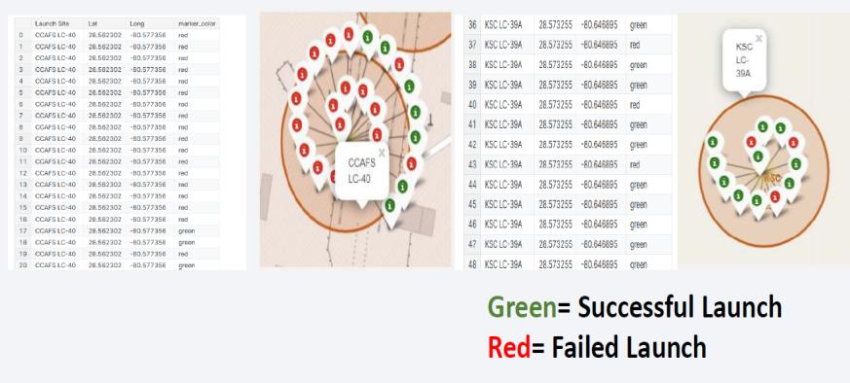
Colour Labels Showing the Launch Sites on a Map

Slide 38
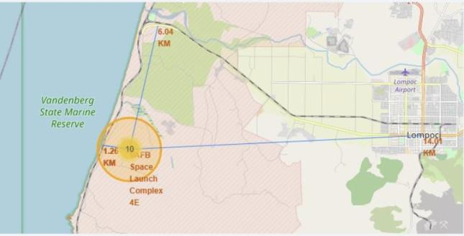
Safe Distance to Launch Site
The obtained results indicate that all launch sites are at safe distance from railway lines and cities.

Slide 39

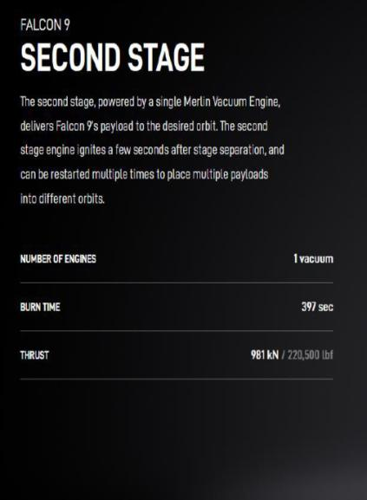
Section 4

Slide 40
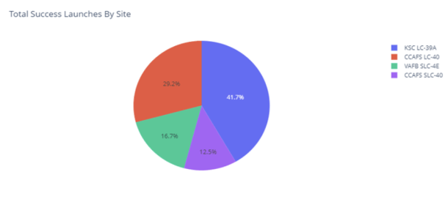
Total Launch Success for All Sites
The highest success launch rates were recorded at these sites :
KSC LC-39A (41.7%)
CCAFS LC-40 (29.2%)

Slide 41
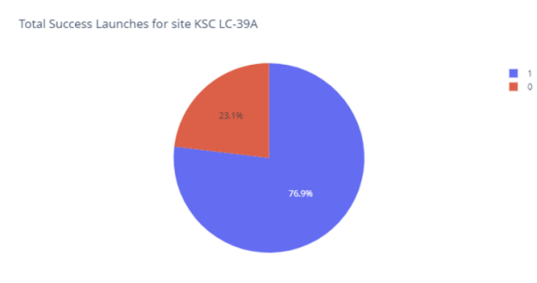
KSC LC-39 Launch Site Success Rate
Site KSC LC-39 success rate is 76.9%

Slide 42
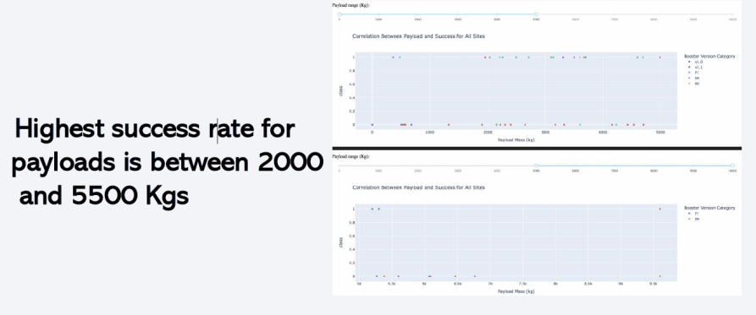
Payload vs. Launch Outcome for All Sites

Slide 43

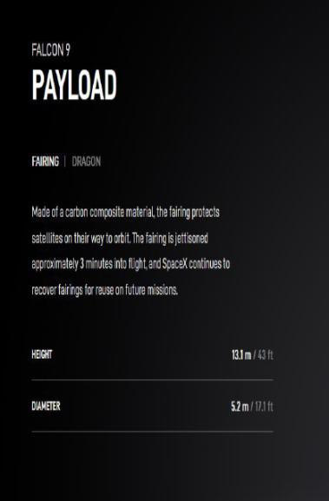
Section 5

Slide 44
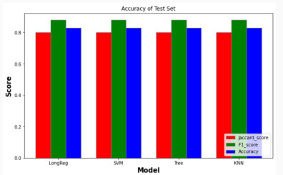
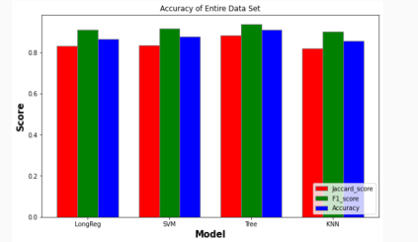
Classification Accuracy
Using the test set the same accuracy results were obtained from the four models.
The Tree Model provided the best accuracy results for the entire data set.

Slide 45
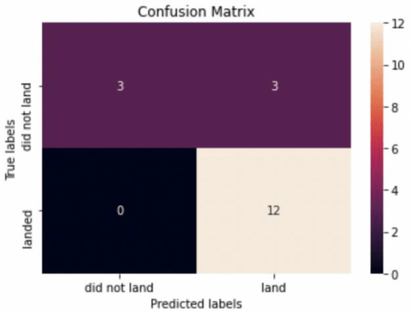
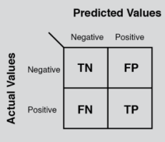
Confusion Matrix
The confusion matrix analysis suggests that the best performing model is the Logistic Regression model.
The confusion matrix predicts 13 true positives, 3 false positives, 3 true positive, and 0 false negative.

Slide 46
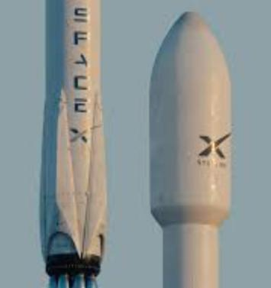
Conclusions
The success rate for the rocket launches increased after 2013.
Orbits GEO, HEO, ES-L1 and SSO have 100% launch success rate.
Launch site KSC LC-39A has the highest success rate.
The Decision Tree model is the best ML algorithm for analysing the SpaceX data set and provided the best accuracy results.

Slide 47
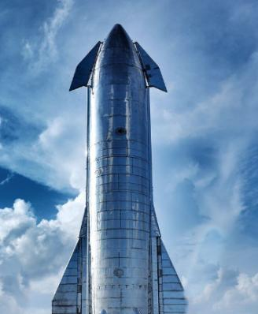
Appendix
https://www.coursera.org/professional-certificates/ibm-data-science?campaignid=1876641588&adgroupid=70740725700&device=c&keyword=ibm%20data%20science%20professional%20certificate&matchtype=b&network=g&devicemodel=&adposition=&creativeid=347445112274&hide_mobile_promo=&gad_source=1

Slide 48
